Slide 1
“Lysosome” Cell Bio 12

Slide 2
Contents:
Introduction
Morphology
Structure
Enzymes
Polymorphic Nature
Functions

Slide 3
1. Introduction:
A lysosome (derived from the Greek words lysis, meaning "to loosen", and soma, "body")
It is a membrane-bound cell organelle found in animal cells (they are absent in red blood cells).
The “garbage disposals” of your cells; they are responsible for digesting and recycling materials that the cell no longer needs or has to get rid of.
Lysosomes are very common in white blood cells, where disease and sickness are fought so a lot bacteria needs to be digested.
Their shape and size vary depending on what material is digested.
They contain about 40 different enzymes (ex. nucleases, proteases, lipases, and carbohydrases).

Slide 4
2. Morphology:
Shape and Size:
Variable.
Morphologically can be compared with Amoeba and white blood cells (W.B.C.).
Vary in size from 0.4 to 0.8цm, but
they may be as large as 5цm in mammalian kidney cells.

Slide 5
3. Structure:
Round tiny bags filled with dense material and digestive enzymes.
Consist of two parts:
(1) Limiting membrane
(2) Inner dense mass.
1. Limiting membrane:
Single.
Composed of lipoprotein.
Chemical structure is homologous.

Slide 6
2. Inner dense mass:
May be solid or of very dense contents.
Some lysosomes have a very dense outer zone and less dense inner zone.
Some others have cavities or vacuoles within the granular material.
Usually they are supposed to possess denser contents then mitochondria.
Permeability of Lysosomal membrane:
Impermeable to substrate of the enzymes contained in the lysosomes. Certain substances called labializes, cause instability of the lysosomal membrane, leading to release of enzymes from the lysosomes. Other substances, called stabilizers, have a stabilizing action on the membrane.
A list of some labializes and stabilizers are giving in Table.

Slide 7
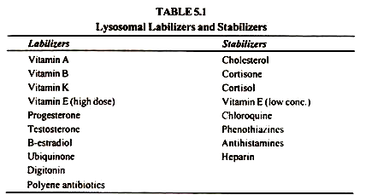

Slide 8
4. Enzymes:
Some important enzymes found within lysosomes include:
Lipase, which digests lipids
Amylase, which digest carbohydrates (e.g., sugars)
Proteases, which digest proteins
Nucleases, which digest nucleic acids
phosphoric acid monoesters.

Slide 9
All these hydrolytic enzymes are produced in the endoplasmic reticulum, and to some extent in cytoplasm are transported and processed through the Golgi apparatus.
Hydrolytic Enzymes: Hydrolytic enzymes break down protein, carbohydrate, and fat molecules into their simplest units. The hydrolysis of polymers by hydrolytic enzymes results in free monomers. During hydrolysis (hydro-,"water";lysis-,"break") a water molecule is added to the polymer and cleaves the covalent bond holding the two monomers.

Slide 10
5. Polymorphic Nature:
Polymorphism, i.e. existence of a structure in more than one form, is an important feature of lysosomes.
Several different forms of lysosomes have been identified within the cell as primary lysosomes, secondary lysosomes, residual bodies and autophagic vacuoles.
1. Primary lysosomes:
These are also called the true, pure or original lysosomes, having a single unit membrane containing enzymes in the inactive forms.
2. Secondary lysosomes:
These are also called the phagosomes as they contain the engulfed material and enzymes. The enzymes present in such lysosome gradually digest the engulfed material.

Slide 11
3. Residual or Lysosomes:
Lysosomal membrane characterized by the presence of undigested materials like myelin figure is called residual body.
4. Autophagic Vacuoles:
The autophagic vacuoles are also known as autophogosomes or cytolysosoms. The autophagic vacuoles are formed when the cell feeds on its intracellular organelles such as the mitochondria and endoplasmic reticulum by the process of autophagy.
C. de Duve (1967) and Allison (1967) have observed that during starvation on the organisms many autophagic vacuoles developed in the liver cells which feed on the cellular components.

Slide 12
6. Functions:
1. Lysosomal Digestion of External Particles:
Large molecules are taken into the cell by the process called phagocytosis.
The cell engulfs the particles and then forms an invagination that becomes pinched off from the cell membrane to become an internal sac or body.
It is referred to as a phagosome, A phagosome then moves towards the lysosome.
Exposure of the material to the lysosomal hydrolases occurs through fusion of the phagosome with a lysosome.
Now the enzymes from the lysosome can come into contact with the molecules brought into the cell in the phagosome and digestion occurs.
Once the molecules are digested, the digested products can diffuse out of the so-called digestive vacuole into the cytoplasm of the cell leaving the residue in the digestive vacuole.
The digestive vacuole now moves on to the cell membrane where the so-called reverse phagocytosis or defecation occurs.

Slide 13
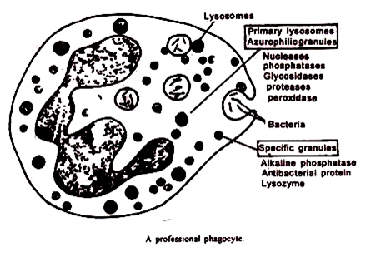

Slide 14
2. Digestion of Intracellular Substance:
Portions of the substances, find their way inside the cell’s own lysosomes and are broken down.
This process is termed as cellular autophagy.
During the starvation of cell these stored food materials are digested by lysosomes to give energy.
3. Cellular Digestion:
Cell dies, lysosomal membrane ruptures, liberated enzymes become free in the cell, which then quickly digest the entire cell.
This is a built in mechanism for removing dead cells.

Slide 15
4. Extracellular Digestion:
A cell can discharge lysosomal enzymes to destroy the surrounding structures.
Digests contagious structures.
5. Role in Secretion:
Formation of secretory products in secretory cells.
Lysosomes- mediated thyroid hormones secretion is the best known example.
Regulation of hormone secretion

Slide 16
6. Chromosome breaks:
Lysosomes contain the enzyme deoxyribonuclease (DNAse).
This enzyme causes chromosomal breaks and their rearrangement.
DNAse has two active sites and breaks down both the strands of DNA. These breaks lead to various syndromes.
7. Role in development and metamorphosis:
Lysosomes are important in development.
During metamorphosis, the process of resorption of the tadpole tail and regression of the various larval tissues, including the fat body and the salivary gland, are accompanied by increased lysosomal acid hydrolase activity (Weber).

Slide 17
8. Role of Lysosomes during Cell Division:
During the cell division, the lysosomes of the particular dividing cell move towards the periphery instead of near the nucleus, as in usual cases they are seen.
During the cytokineses equal number of them move towards opposite poles.
Sometimes during cell-division certain repressors in cytoplasm inhibit cell-division. Lysosomes secrete certain depressors which destroy the repressor and results in cell division (Allison, 1967).

Slide 18
9 . Help in protein synthesis:
Novikoff and Essner (1960) have suggested the possible role of lysosomes in protein synthesis.
Recently, Singh (1972) has correlated lysosomal activity with the protein synthesis.
In the liver and pancreas of some birds, lysosomes seem to be more active and developed showing possible relationship with cell metabolism.
10 . Lysosomes and cancer:
Malignant cells are found to contain abnormal chromosomes; it is presumed that the chromosomal abnormality is caused by chromosomal breakage produced by the lysosomal enzymes.
The partial deletion of chromosome 21 in man is associated with the chronic myeloid leukemia (blood cancer).

Slide 19
11. Removal of dead cells:
Hirsch and Cohn (1964) suggested that lysosomes help in the removal of dead cells in tissue.
The lysosomal membrane raptures in these cells, releasing the enzyme into body of cell, so that whole cell may be digested.
This process of tissue degeneration (necrosis) is due to this lysosomal activity.
14. Lysosomes and disease:
Inhalation of foreign particles like silica, etc., leads to inflammation and deposition of fibrous tissue in the lungs.
The particles of silica increase the permeability of lysosomal membranes and rapture of lysosomes.
This leads to the lysis of lung cells resulting in their inflammation.
A metabolic disorder, the gout, is caused by the accumulation of sodium orate crystals in the joints. These are picked up by the phagocytes resulting in their lysosome rupture.

